Slide 1
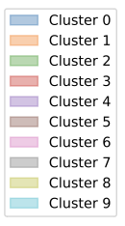
b.
a.
pSTAT3 in CD4T and Myeloid derived cells
c.
d.

